Slide 1
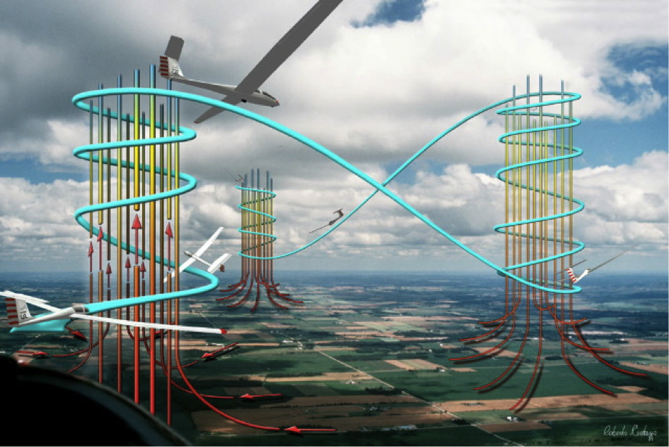
Thermalling Skills -3
Larry Suter
Air Sailing Thermal Camp
June 8, 2016

Slide 2
Thermal Camp Goals
Be able to consistently turn in ~20 second circles with good air speed control
Begin to be able to quickly center a “well behaved” thermal
This is a lifelong study
Start developing a mental picture of thermals and act on it
Begin to learn how to find the next thermal (and the next and the next…)
Don’t be stuck in a house-thermal
This is a lifelong study
Practice flying faster between thermals
Become familiar with online tools that that predict soaring weather.
“Safety” really is about risk reduction. Flying involves risk. Recognize that safety talks really are about ways in which we can mitigate risk posed by hazards that have already been identified.

Slide 3
In this talk we’ll be discussing finding the next thermal and flying faster between thermals
Be able to consistently turn in ~20 second circles with good air speed control
Begin to be able to quickly center a “well behaved” thermal
Become aware of several techniques. The one that works best for you may depend on your equipment.
Start developing a mental picture of thermals and act on it
Begin to learn how to find the next thermal (and the next and the next…)
Don’t be stuck in a house-thermal
This is a lifelong study
Practice flying faster between thermals
“Safety” really is about risk reduction. Flying involves risk. Recognize that safety talks really are about ways in which we can mitigate risk posed by hazards that have already been identified.

Slide 4
As motivation for the topics, let’s begin with a tirade from Mark Montague:
Consider the following scenario:
•in your club, you’re limited to 1 hour of flight when others are waiting
•you wait your turn
•you launch and release into the “house thermal”
•you climb to the top of the lift, then grind away for a while
•eventually, you get bored and decide to find another thermal
•you immediately lose a chunk of that hard-won altitude
•you persist in your quest anyway—for maybe 30 seconds!
•you scurry back to the safety of the house thermal
Has this ever happened to you? If so--
This is negative training!

Slide 5
Successful cross-country flight depends on straight flight between thermals. This
is so blindingly obvious that it is often overlooked—and most clubs’ rules only
make the situation worse. (In all fairness, often clubs really have no choice.)
To progress as a soaring pilot, it is necessary to re-think your sense of time scales
and to be willing to spend significant time gliding between thermals. The skills
involved in re-centering a known thermal are much less crucial than being able to
readily locate new thermals time after time.
Consider an actual flight from Air Sailing to the Black Rock Desert, flown on June
25, 2001. The total distance flown was 52 nm; total duration was 2:00.
•the weather was extremely weak—drizzle fell at dawn, the day was completely
overcast and cloud bases never allowed altitudes above 11,500’ msl at best.
•the first 30 minutes were spent on the Red Rocks, just trying to remain airborne
•average climb rate was 330 ft/min; average time in each thermal was 6 min
•once the decision to leave the field had been made, just 5 thermals were used—
or one thermal every 18 minutes!
On a stronger day, the thermal tops (and the climb rates) would have been higher,
leading to longer interthermal glides. However, these interthermal glides would
have been flown at higher airspeeds—so the time between thermals would not
have been significantly longer. These times are typical for 15 meters or less.
Bottom line: even on weak days, expect to
Spend minutes, not seconds, between thermal climbs!

Slide 6
To avoid being in Mark’s “club flying” mode you need to:
Learn how to find the next thermal,
Fly faster between thermals (speed to fly)
Know when to leave a thermal

Slide 7
Recall that to find thermals glider pilots look for:
Cumulus clouds (“CUs”)
Haze domes
Dust devils
Circling birds
Circling gliders!
Go where the lift should be
High Terrain
High Terrain where there’s convergence
Local knowledge
Cumulus clouds (“CUs”)

Slide 8
Around here the principal ways of finding the next thermal are:
Cumulus clouds (“CUs”)
Go where the lift should be
High Terrain
High Terrain where there’s convergence
Local knowledge
Circling gliders!
Cumulus clouds (“CUs”)

Slide 9
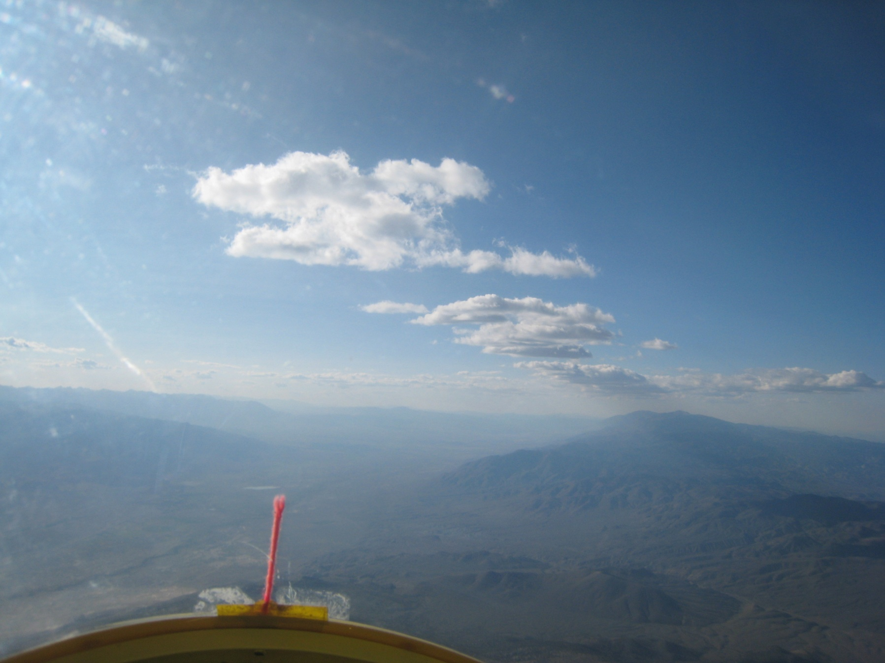
Finding the next thermal:
When there are cumulus clouds the decision is typically easy…
Go where the CU’s are
Sharp outline- Building
Indistinct outline- Dissipating
Concave Upward Base- Strong Lift
And be wary of where the clouds aren’t

Slide 10
What do you do when there isn’t enough moisture to create nice CU?
Go where the lift should be
High Terrain
High Terrain where there’s convergence
Local knowledge

Slide 11
What kind of convergence might be established by an Easterly flow?

Slide 12
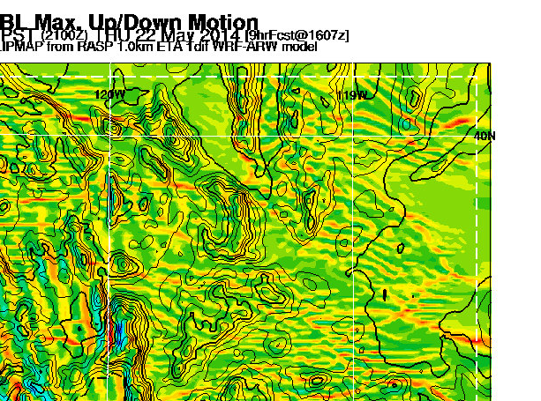
Convergence with Easterly Flow

Slide 13
What kind of convergence might be established by a Westerly flow?

Slide 14
Convergence with Westerly Flow

Slide 15
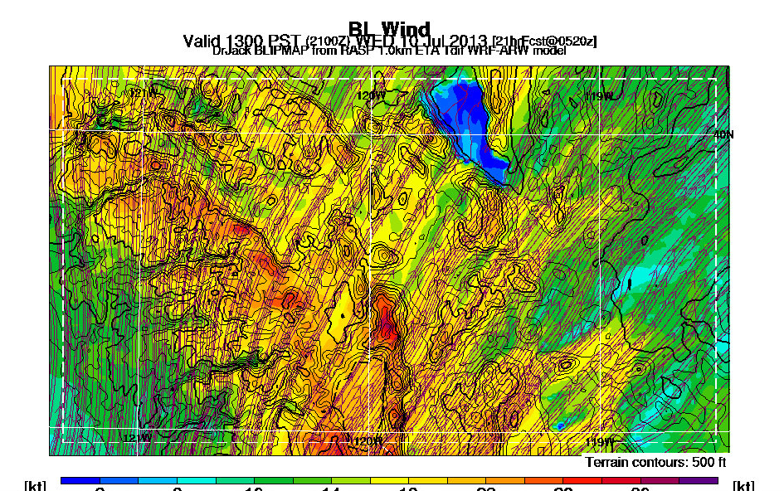
Southerly flow
Honey Lake
7990
ASI
Petersen’s
Fred’s
Peavine
Verdi
TRK
Mt Rose

Slide 16
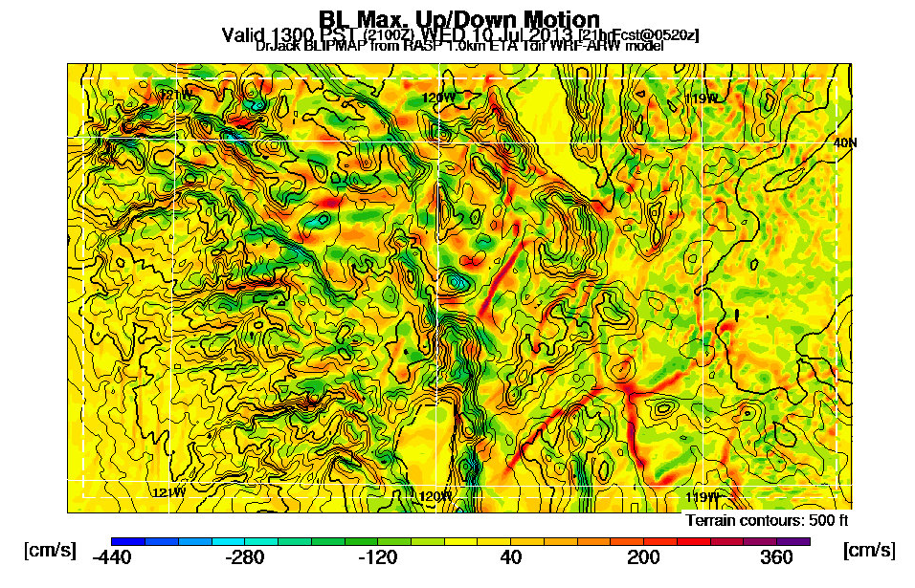
Convergence with southerly flow
Honey Lake
7990
ASI
Petersen’s
Fred’s
Peavine
Verdi
TRK
Mt Rose

Slide 17
What do you do when there isn’t enough moisture to create nice CU?
Go where the lift should be
High Terrain
High Terrain where there’s convergence
Local knowledge
Pay particular attention to wind direction
Go to where the convergence should be generating lift
This requires preparation, study and learning
This information is available at
http://www.norcalsoaring.org/BLIP/SIERRA/index.html
(A Dr. Jack weather product)

Slide 18
The speed to fly between thermals depends on the amount of sink and the amount of wind
Speed to fly for dummies- 10 to 15 knots faster than best L/D
Speed to fly via MacReady Ring can give you the correct speed to fly for the amount of sink
Speed to fly via flight computer with pitot and GPS input can give you the correct speed to fly for both the wind and sink

Slide 19
The basis of the MacReady Ring is the glider’s polar
Speed to fly for zero sink
Airspeed
0
Vertical speed
Maximum distance traveled per unit altitude loss when line from 0,0 is tangent to the polar
Polar with zero sink

Slide 20
Flying in sink is equivalent to flying a glider whose polar is shifted down by the amount of sink
Speed to fly with sink
Airspeed
Vertical speed
Polar with zero sink
Polar with sink

Slide 21
For a given amount of sink there a “shifted polar” that gives Airspeed for best L/D. The shifted polar also tells you the total descent rate at that speed. This allows us to construct a table of airspeed for best L/D vs variometer reading
Airspeed for best L/D
Variometer reading
0

Slide 22
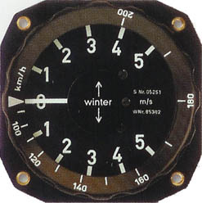
A ring surrounding the vario tabulating your glider’s Airspeed for best L/D vs vario reading is called a MacReady Ring
Airspeed for best L/D
By flying the airspeed indicated by the vario, you are flying at the speed to fly for the sink
Variometer reading
0

Slide 23
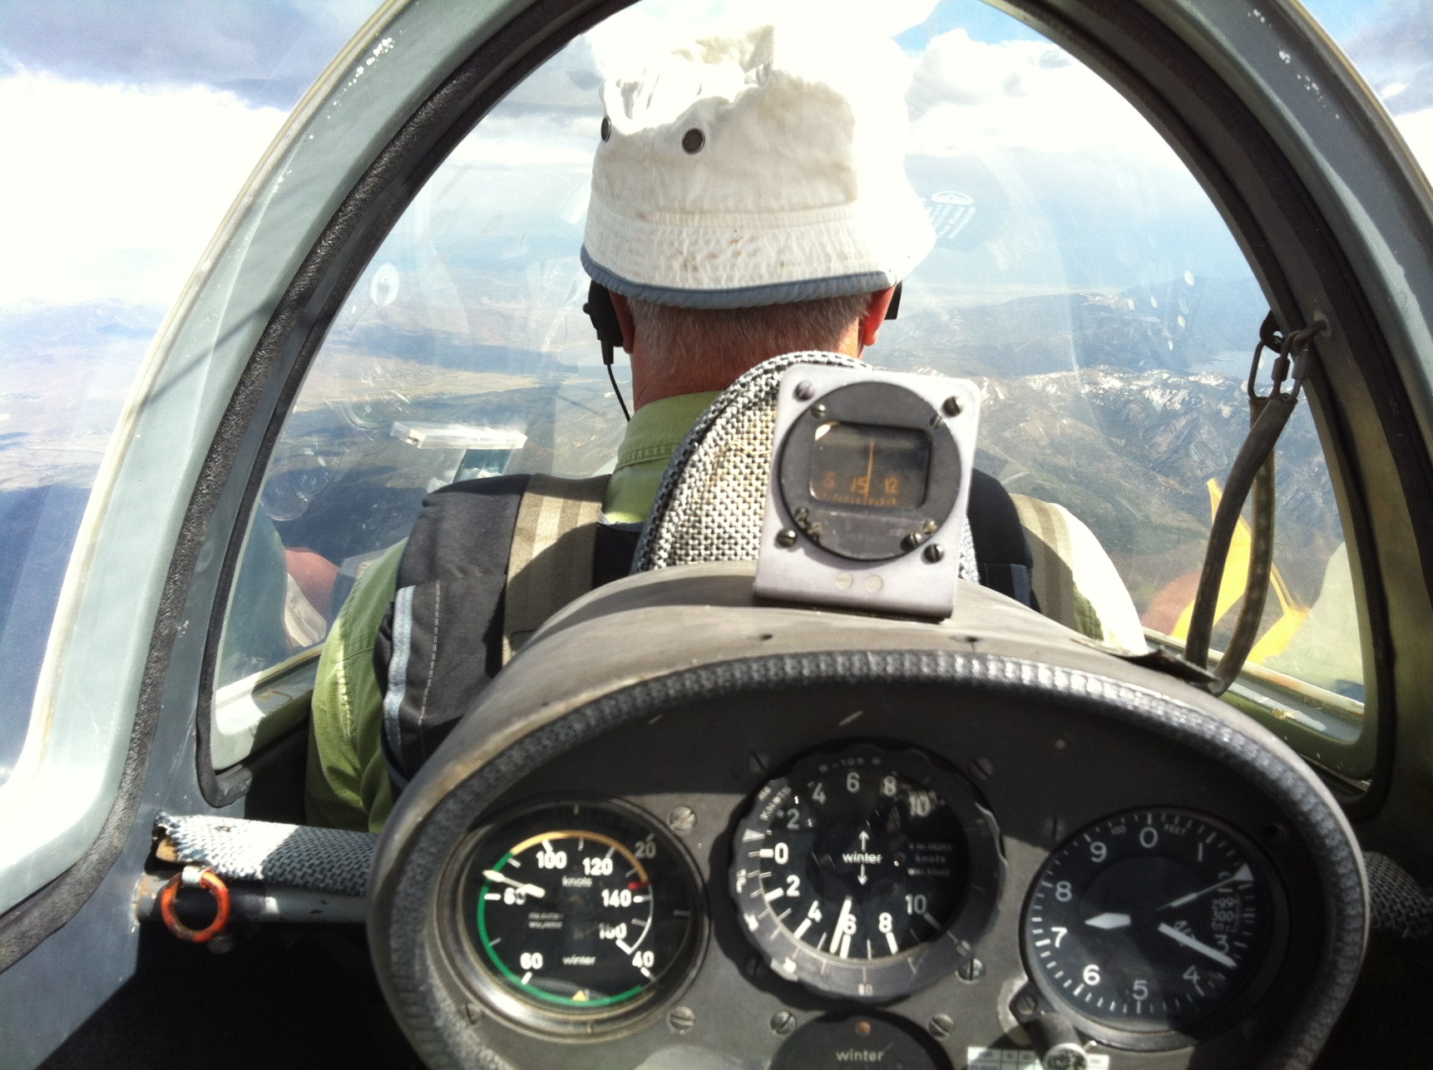
John Scott flying fast in sink

Slide 24
Note that serious cross country pilots advocate rotating the ring so the pointer is at some value >0
MacReady Ring setting for dummies: +1 or +2 knots

Slide 25
A lot of folks say to leave a thermal when the lift has decreased to about ¾ or ½ of peak achieved rate of climb for a turn or two
This well may occur when your up in the mushroom cap of the thermal
Ramy Yanetz advocates doing a Crazy Ivan when you leave a thermal. You may enter something that efficiently gets you several hundred feet more.

Slide 26
Mark Montague on when to leave a thermal:
Classic MacCready theory tells us that the proper time to leave a thermal is
when the rate of climb achieved in it falls below the rate of climb
expected in the next thermal.
Truth is, classic MacCready theory doesn’t have to contend with a number of
factors that really matter in the real world. Here are a few of them:
·You might need additional altitude to clear high terrain further along your route
·You might be in the last thermal of the evening and can’t expect to find another
one before reaching your destination
·You might need additional altitude so as to avoid losing too much altitude in
crossing a ridge from the downwind side, a body of water or any other known or
suspected area of strong sink. (These types of sink are strongest down low.)
·You might need to accept a poor climb rate during the final stages of thermalling
into wave, or when planning to penetrate upwind into wave
These are all valid reasons to continue your climb even though the climb rate has
fallen below the “next thermal” rate. The important point is, you must have in
mind a clear idea of what it is you’re trying to accomplish before you can make a
rational decision about when to remain in a thermal and when to leave it.
Always have a plan!

Slide 27
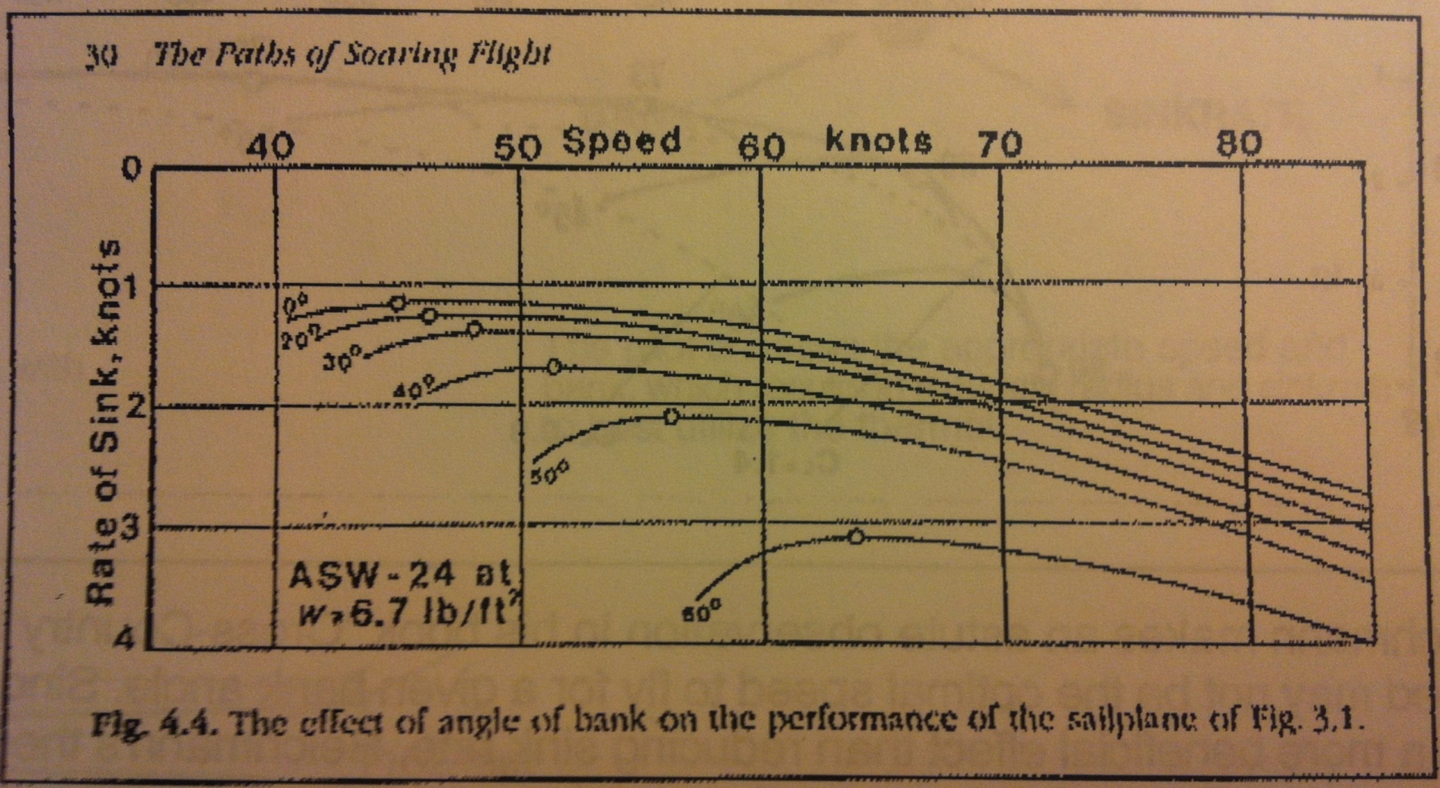
Technical Thermalling: As you increase bank angle to make your circle smaller, the glider’s sink rate increases
Load factor increases with bank angle
Airspeed increases as the square root of the load factor
Drag increases with the load factor (L/D is fixed)
So a glider’s rate of sink increases as load factor to the 1.5 power
(since m*g*rate_of_sink = D*airspeed)

Slide 28
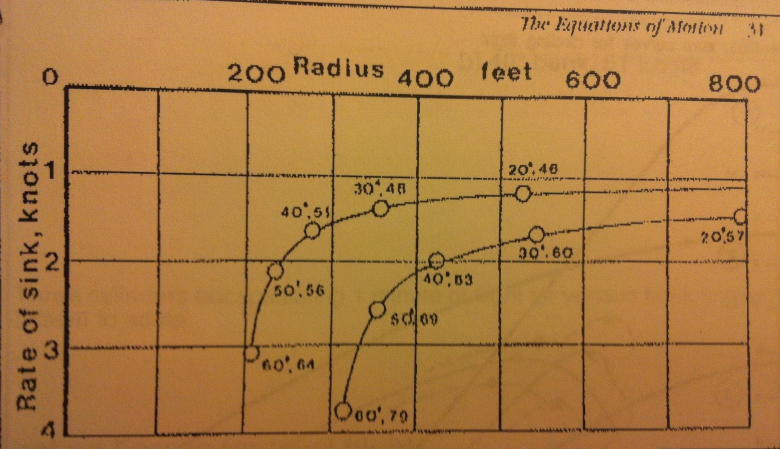
For bank angles >45 degrees, additional decrease in radius of circling causes a significant increase in sink rate
For competition pilots the marginal gain of thermalling at bank angles > 45 degrees may be worth the effort. Probably not true for most recreational pilots.

Slide 29
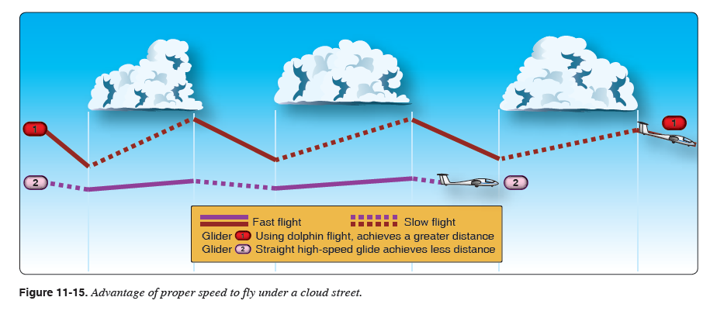
Dolphin flight can be used to cover surprising distances on thermal days with little or no circling
From Glider Flying Handbook: Another way to increase cross-country speed is to avoid turning at all. A technique known as dolphin flight can be used to cover surprising distances on thermal days with little or no circling. The idea is to speed up in sink and slow down in lift while only stopping to circle in the best thermals.

Slide 30
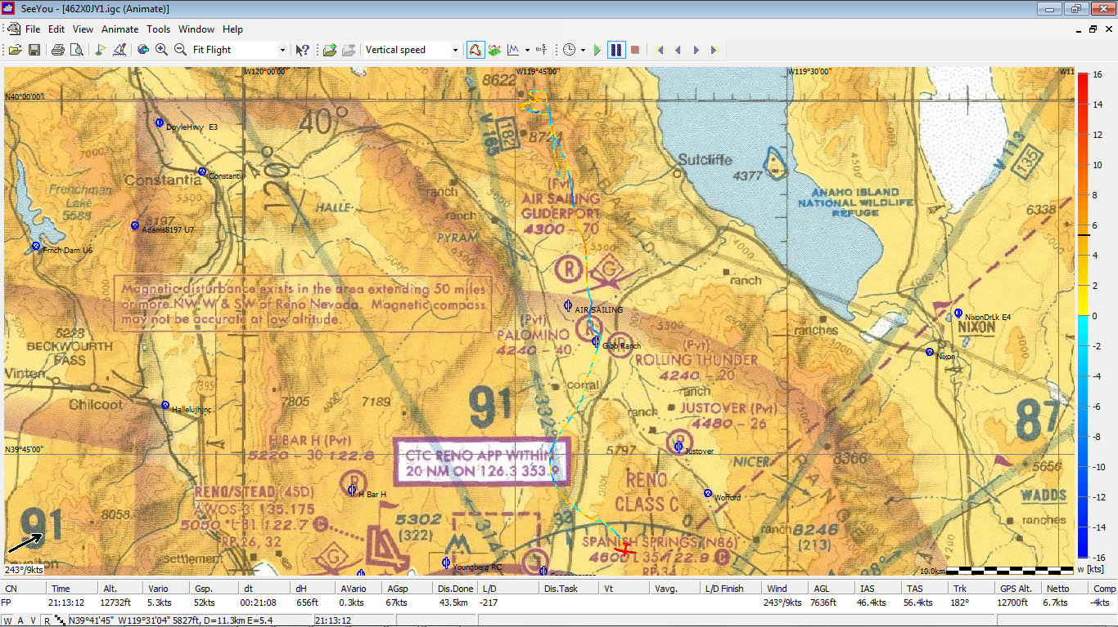
An example of dolphin flight is Andrew’s 43km segment on Monday from Tule to Spanish Springs
Average speed of 67 knots (123 km/hr)
Dolphin flight is a great way to “Fly Faster Between Thermals”

Slide 31
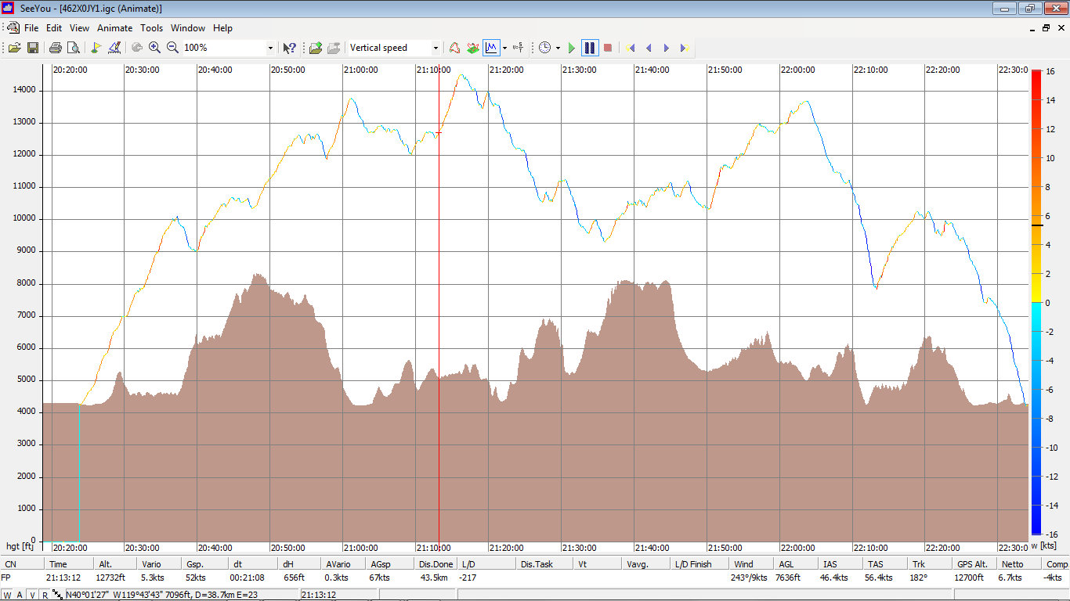
Try dolphin flight high above the Tule Ridge and Red Rocks or under a line of clouds
Dolphin Start
Dolphin End

Slide 32
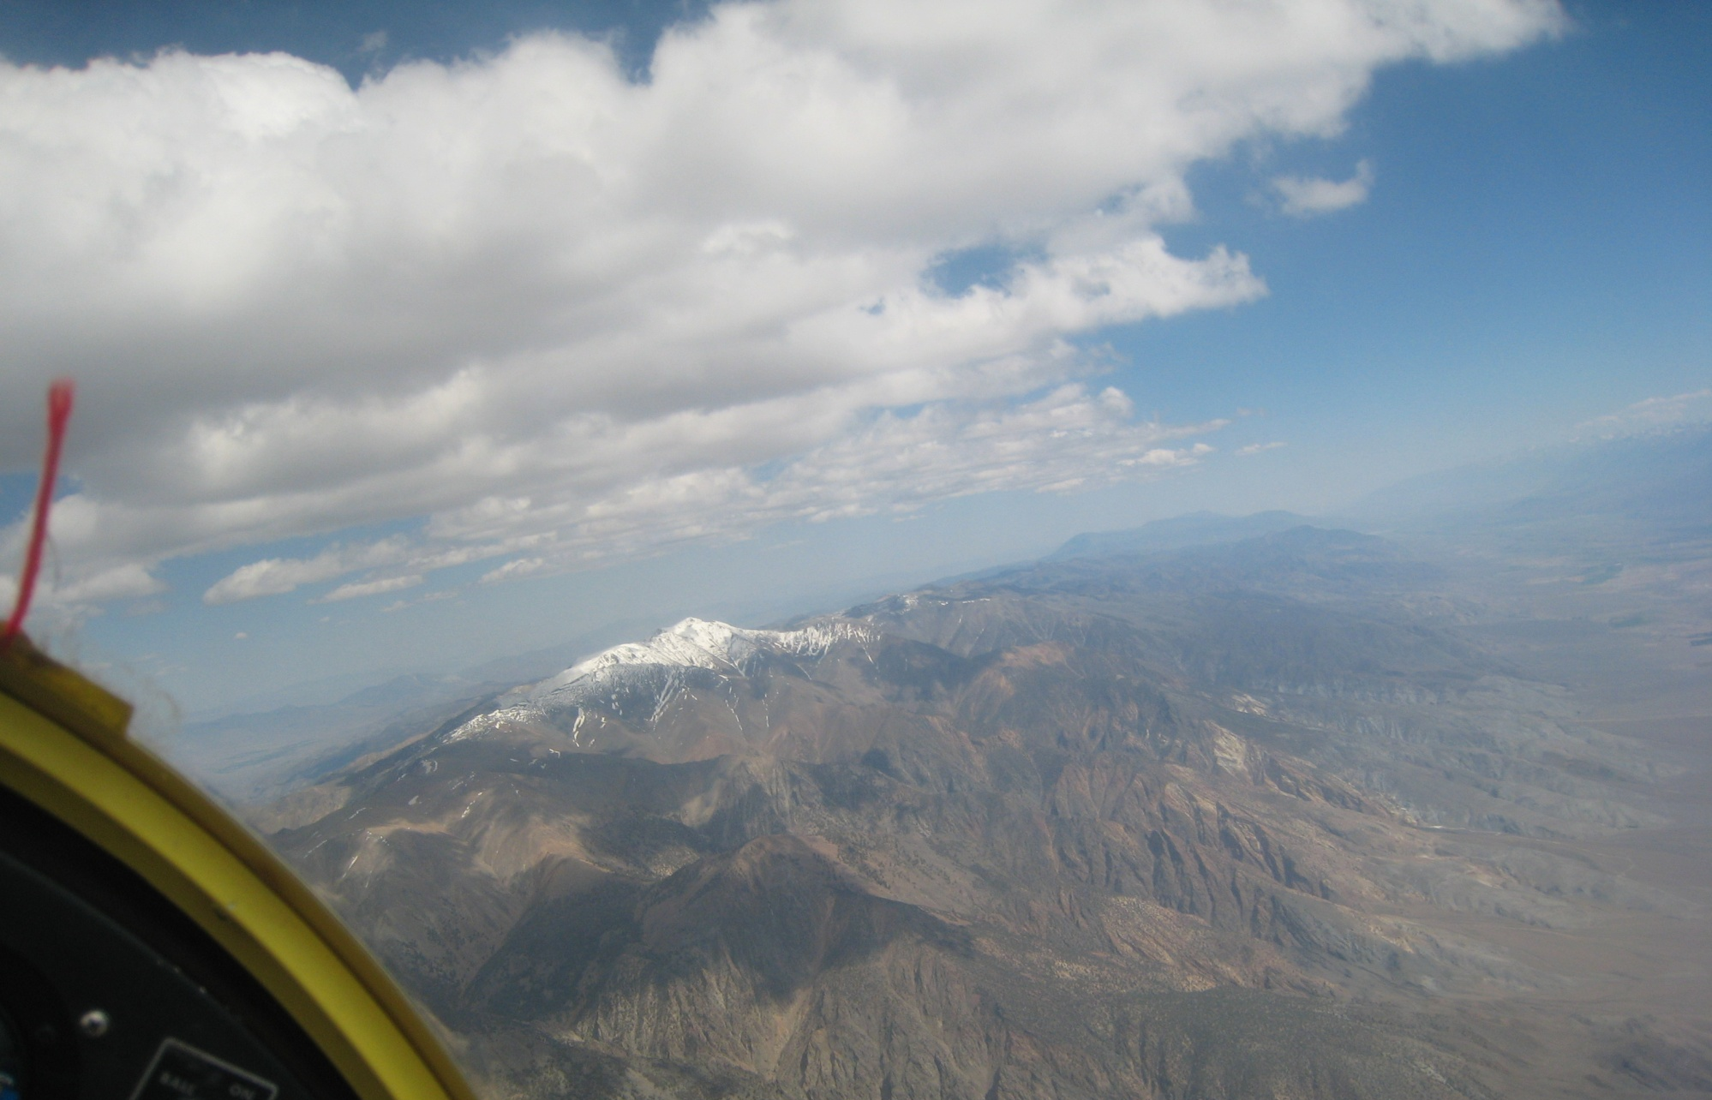
A line of clouds saying, “Please Dolphin”

Slide 33
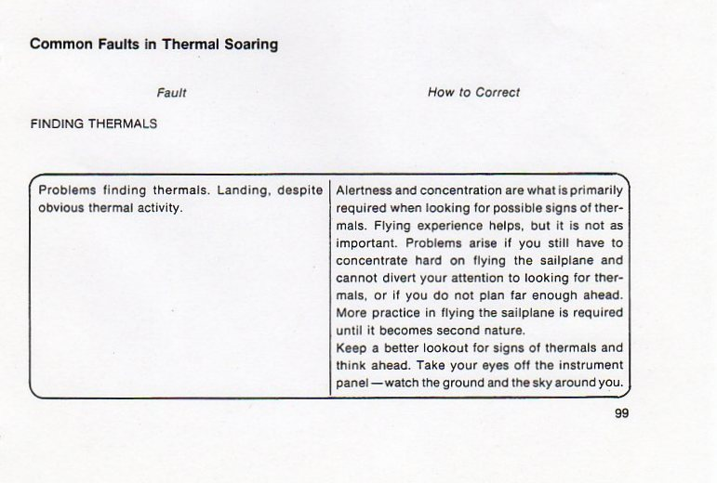

Slide 34
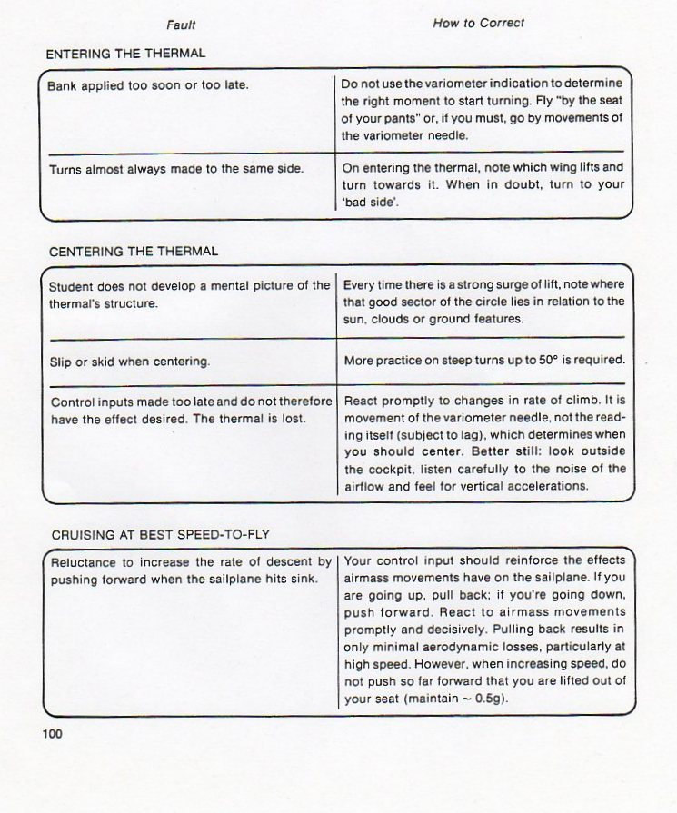

Slide 38
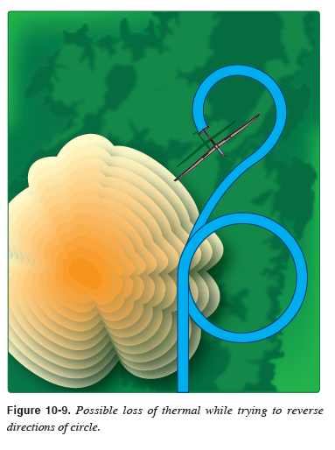
Another common error is to reverse the direction of circle*
Guaranteed way to lose the thermal
*Except for Ramy’s Crazy-Ivan manouver as he’s exiting the thermal

Slide 39
A few more thermalling exercises from Helmut Reichmann

Slide 40
Yesterday’s suggestion

Slide 41
Blue Thermal Exercise- Try it over the Dogskins or Red Rocks/Tule ridge

Slide 42
This is particularly good as you approach a flat, dark cloud where you expect good lift

Slide 44
Fly like a bird from time to time; it’s great fun

