Slide 1
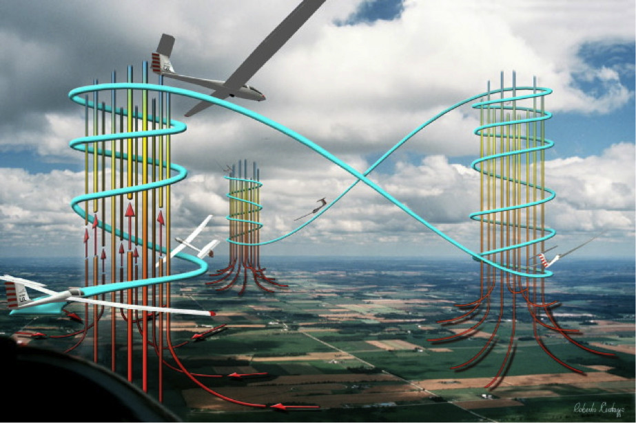
Thermalling Skills -1
Larry Suter
Air Sailing Thermal Camp
June 6, 2016

Slide 2
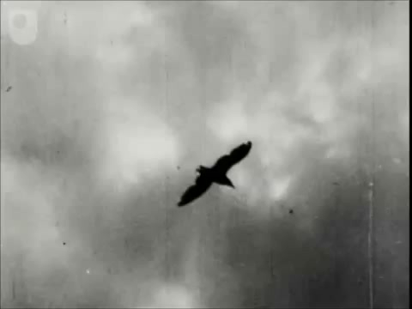

Slide 3
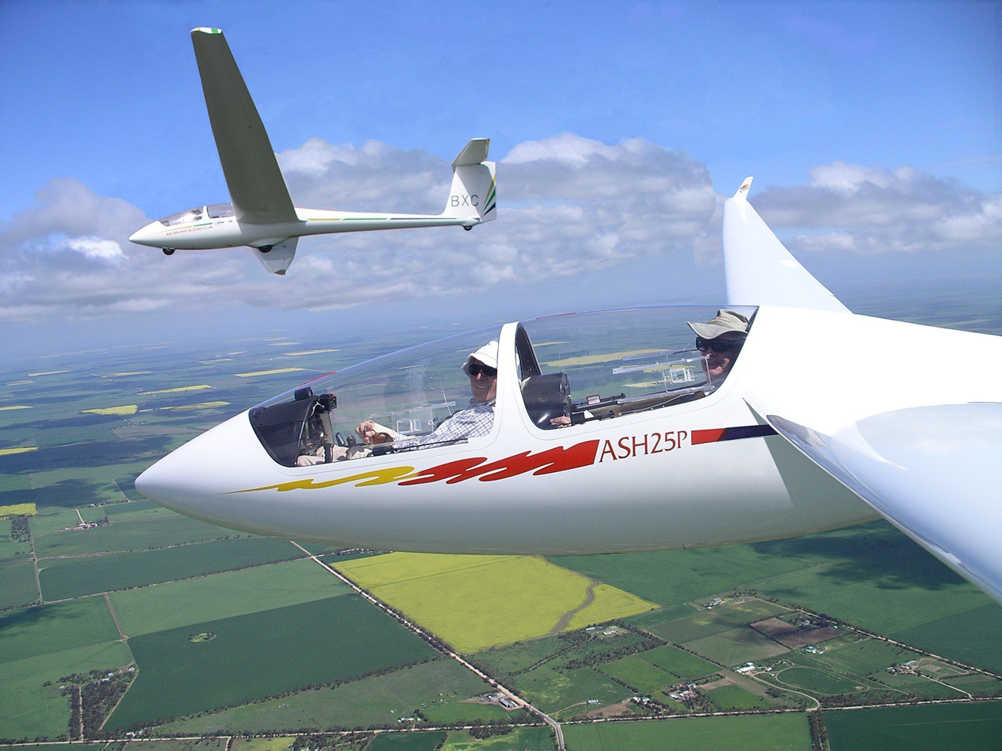
Once released from aerotow, a glider is
“at the mercy of gravity and air currents.
But that’s not as restricting as you might think.”

Slide 4
What keeps a glider in the air?
Glider pilots use rising air currents, called lift, to keep their gliders airborne for long periods
There are three types of lift used by glider pilots
Thermals are rising columns of warm air
Ridge lift is created by wind blowing up a slope
Wave lift is created by stable air blowing over the top of a mountain range
Thermal Lift
Ridge Lift
Wave Lift

Slide 5
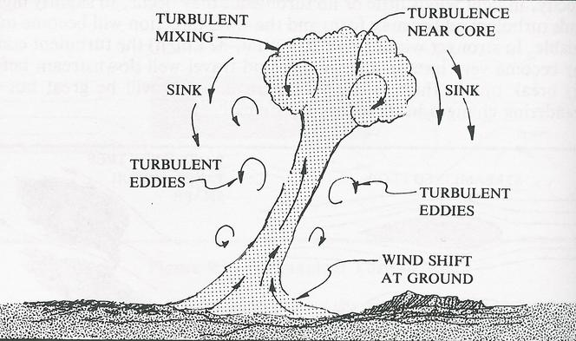
Thermal Lift
Thermals are rising columns of air that was heated by sun on the ground
The air cools as it rises, and a cloud often forms when the moisture in the air condenses
This cloud “marks” the lift, making it easier to find

Slide 6
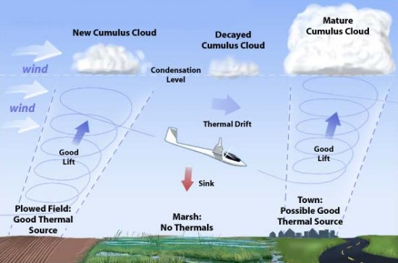
Thermal Lift
You’re here because you already know that glider pilots circle in thermals to gain altitude

Slide 7
By climbing in one thermal and then moving on to the next, then the next, etc., glider pilots can cover great distances
Unfortunately, thermals are a little harder to locate and “center” than indicated in this picture.

Slide 8
The fundamental questions of thermalling are:
Where should I be looking to find a thermal?
Is this a thermal?
When should I begin turning?
Which way should I turn?
How do I go about “centering” the thermal (be in strong lift the entire circle)?

Slide 9
The fundamental questions of thermalling are:
Where should I be looking to find a thermal?
Is this a thermal?
When should I begin turning?
Which way should I turn?
How do I go about “centering” the thermal (be in strong lift the entire circle)?
In this talk, we’ll attempt to answer questions 2-5

Slide 10
WRT answering:
Is this a thermal?
When should I begin turning?
A key bit of information is:

Slide 11
2. Is this a thermal?
The first indicator of a nearby thermal is often increased sink.
Next, a positive G-force is felt, which may be subtle or obvious, depending on the thermal strength.
The “seat-of-the-pants” indication of lift is the quickest, and is faster than any variometer, which has a lag.
Note the trend of the variometer needle (should be an upswing) or the audio variometer going from the drone to excited beeping.

Slide 12
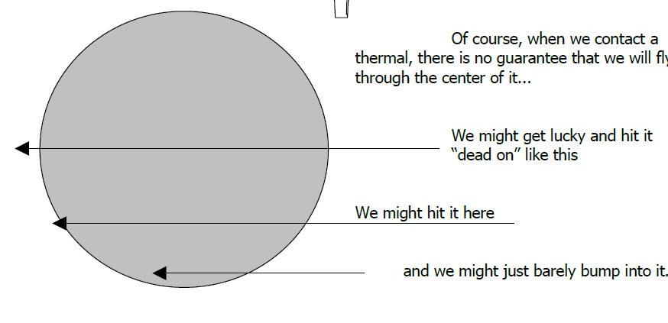
Of course, when we contact a thermal, there’s no guarantee that we will fly through the center of it
If we barely bump into a thermal, we’ll experience lift for only a brief period of time.
However, gusts that don’t mean anything also create lift for brief periods of time
So how do you know if a brief period of lift is a gust or the edge of a thermal?
Answer: You don’t.
However, lift that lasts <3 seconds has <10% probability of being a thermal with a diameter of “6 seconds” or greater.

Slide 13
Rule of Thumb: Reject any encounter with lift that’s <3 seconds
If the lift lasts longer than this, there’s a reasonable chance you’ve encountered a thermal that’s large enough to provide lift for most of a turn that has “a diameter of six seconds” or greater
~3 seconds
~1 second

Slide 14
The first indicator of a nearby thermal is often increased sink.
Next, a positive G-force is felt, which may be subtle or obvious, depending on the thermal strength.
The “seat-of-the-pants” indication of lift is the quickest, and is faster than any
variometer, which has a small lag.
Note the trend of the variometer needle (should be an upswing) or the audio variometer going from the drone to excited beeping.
And now you’ve been in this lift for three seconds
Is this a thermal?- Most likely!
When should I begin turning?
Today’s answer: At three seconds!!!!!!!
You must be decisive in soaring
“Turn briskly and positively into the thermal”
Be sure to clear the area before turning!!!!
But wait a minute…..
Which way should I turn?

Slide 15
Which way should I turn?
Many new soaring pilots seem to spend too much time and attention on deciding which way to turn upon finding a thermal.
Most instructors will tell you that it isn’t at all uncommon to fly completely through the thermal before the decision has been made!
This is unnecessary since the decision is easy and you’ve had three whole seconds to mull it over

Slide 16
Mark Montague’s 5 Rules For Deciding Which Way to Turn:
(simply go down the list and apply the first rule that applies)
1) If close to high terrain, turn away from the terrain
--you don’t want to collide with the terrain, nor do you want (if low)
to drift downwind and into the sink beyond the crest
2) If close to other traffic, turn so as to minimize the collision risk
--this includes matching the turn direction in use by another glider
already climbing in the thermal you’re about to use
3) If you sense one wing being lifted by the thermal, turn toward that wing
--the thermal core is likely to be in that direction
4) If you’re on a generally cross-wind heading, turn into the wind
--the upwind edge is likely to be the strongest part of the thermal
5) If no other rule applies, recall what direction you turned in the last thermal you used, and turn the opposite way
--you want to develop equal facility with turns in either direction

Slide 17
How do I go about “centering” the thermal (be in strong lift the entire circle)?
sink
Wind
2 kts
5 kts
8 kts
+3
3 sec of audio vario chirping “up”
+1
-3

Slide 18
sink
Wind
2 kts
5 kts
Here you are, in lift, slightly turbulent, no obvious wing rising, which way do you turn?
8 kts
3 sec

Slide 19
Mark Montague’s 5 Rules For Deciding Which Way to Turn:
(simply go down the list and apply the first rule that applies)
1) If close to high terrain, turn away from the terrain
--you don’t want to collide with the terrain, nor do you want (if low)
to drift downwind and into the sink beyond the crest
2) If close to other traffic, turn so as to minimize the collision risk
--this includes matching the turn direction in use by another glider
already climbing in the thermal you’re about to use
3) If you sense one wing being lifted by the thermal, turn toward that wing
--the thermal core is likely to be in that direction
4) If you’re on a generally cross-wind heading, turn into the wind
--the upwind edge is likely to be the strongest part of the thermal
5) If no other rule applies, recall what turn direction you used in the last thermal you used, and turn the opposite way
--you want to develop equal facility with turns in either direction

Slide 20
CLEAR BEFORE TURNING!
sink
Wind
2 kts
5 kts
8 kts
3 sec

Slide 21
You find the lift decreases, then turns to sink
You guessed wrong….. ☹
Now what?
sink
Wind
2 kts
5 kts
-1
+4
8 kts
3 sec
+1
-6
-3

Slide 22
When the vario starts going up roll out of your turn, fly a bit, then roll back into the turn
Mentally note the lift in this turn
sink
Wind
2 kts
5 kts
8 kts
3 sec
Vario rising and >0

Slide 23
This turn is better than the first (good sign!) but still a mixture of lift and sink
sink
Wind
2 kts
5 kts
8 kts

Slide 24
Repeat the same centering technique on this turn
When the vario starts going up roll out of your turn, fly a bit, then roll back into the turn
Mentally note the lift in this turn
sink
Wind
2 kts
5 kts
8 kts
3 sec
Vario rising and >0

Slide 25
Repeat the same centering technique on this turn
When the vario starts going up roll out of your turn, fly a bit, then roll back into the turn
Mentally note the lift in this turn
sink
Wind
2 kts
5 kts
8 kts
3 sec
Vario rising and >0
We use the rise of the vario as our cue to roll out and not absolute vario values because of variometer lag, which we will discuss tomorrow

Slide 26
Keep doing the same thing on each turn until you think you’re about centered
When the vario starts going up roll out of your turn, fly a bit, then roll back into the turn
Mentally note the lift in this turn
sink
Wind
2 kts
5 kts
8 kts
Vario rising and >0
3 sec

Slide 27
In this idealized thermal, three corrections nearly have you centered
sink
2 kts
5 kts
+7
+6
8 kts
+5
+4
But you don’t know that. You know THERE’S 7 KNOTS!!! On the NW side of this thermal

Slide 28
So once again when the vario starts going up you roll out of your turn, fly a bit, then roll back into the turn
sink
2 kts
5 kts
+5
+3
8 kts
+8
+4
3 sec
To your disgust you discover that the peak lift has moved to “the other side of the circle”, and the side that was peak is now quite weak
But you’ve gathered information about the thermal

Slide 29
Once you’re circle includes the strongest part of the lift, rolling out on the rising vario and counting 3 seconds can move you into weaker lift
sink
2 kts
5 kts
+5
+3
8 kts
+8
+4
3 sec

Slide 30
The best soaring pilots aren’t necessarily those with sophisticated metoerological training, but those who are quick to notice—and to make effective use of—those patterns that other pilots just don’t catch.
sink
2 kts
5 kts
+5
+3
8 kts
+8
+4
3 sec

Slide 31
If you think your circle includes the strongest part of the lift, make quicker corrections on the rising vario. Basically, partially roll out and immediately roll back in.
sink
2 kts
8 kts
5 kts
3 sec
This is part of a process called “forming a mental image of the thermal”
Pilots who thermal well tend to form good mental images of the lift and act on it
With practice you can be “right” most of the time

Slide 32
How does the techinque work when we hit the thermal almost dead-on?
sink
Wind
2 kts
5 kts
8 kts
3 sec

Slide 33
No wing raises so we decide to turn into the wind
sink
Wind
2 kts
5 kts
8 kts
+10
3 sec

Slide 34
One correction on the rising vario and we’re pretty much centered in this idealized thermal
sink
2 kts
5 kts
8 kts
+10
3 sec
Vario rising and >0

Slide 35
Of course now we’re only seeing 5-7 knots of lift and on that 1st turn there was 10 KNOTS!!!
sink
2 kts
5 kts
8 kts
3 sec
Do we try to center again, looking for that 10 KNOT thermal? ☺

Slide 36
Simple answers to the fundamental questions of thermalling are:
Where should I be looking to find a thermal?
Is this a thermal?
If you’re in lift for 3 seconds, assume it’s a thermal
When should I begin turning?
After you’ve been in lift for 3 seconds
Which way should I turn?
The set of rules tells you
How do I go about “centering” the thermal (be in strong lift the entire circle)?
Roll out on a rising, positive vario, then roll back in again
The roll-out, roll back in should take about three seconds

Slide 37
Mark Montague’s 5 Rules For Deciding Which Way to Turn:
(simply go down the list and apply the first rule that applies)
1) If close to high terrain, turn away from the terrain
--you don’t want to collide with the terrain, nor do you want (if low)
to drift downwind and into the sink beyond the crest
2) If close to other traffic, turn so as to minimize the collision risk
--this includes matching the turn direction in use by another glider
already climbing in the thermal you’re about to use
3) If you sense one wing being lifted by the thermal, turn toward that wing
--the thermal core is likely to be in that direction
4) If you’re on a generally cross-wind heading, turn into the wind
--the upwind edge is likely to be the strongest part of the thermal
5) If no other rule applies, recall what direction you turned in the last thermal you used, and turn the opposite way
--you want to develop equal facility with turns in either direction

Slide 38
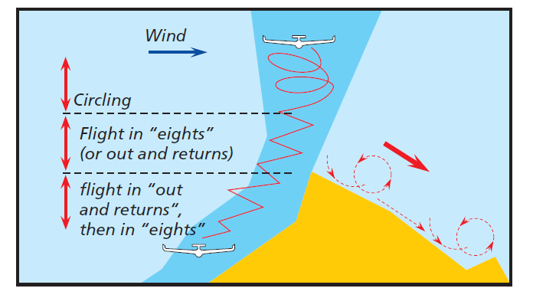
You must be well clear of terrain when circling using any circling technique.
Flying near mountains is dangerous
Don’t use a circling technique near the Dogskins or Red Rocks when part of your circle will be less than 500’ above the terrain underneath
When less than 500’ above terrain, fly figure-eights

Slide 39
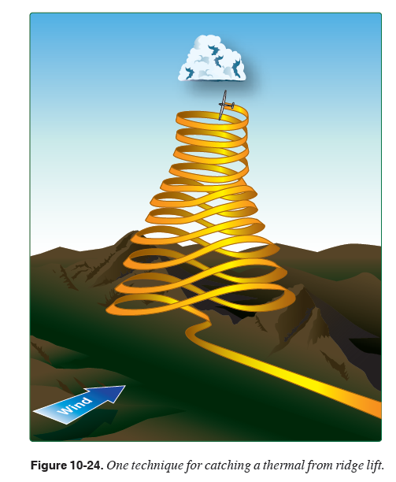
Figure-eights
Never “aim” more than 30 to 45 degrees into the mountain (where 90 degrees would be right at it)
Airspeed well above minimum sink speed for good control authority
(>60 kts glass; 60 mph Schweizer)
Always ready to turn away from the mountain
We have several instructors, mentors and two-place gliders to help you learn figure-eight climbs and we’ll be talking more about it tomorrow.

Slide 40
Once released from aerotow, a glider is
“at the mercy of gravity and air currents.
But that’s not as restricting as you might think.”

